Slide 1





Joins, Subqueries and Indices
Data Retrieval and Performance
Databases
Basics
SoftUni Team
Technical Trainers
Software University
http://softuni.bg

Slide 2



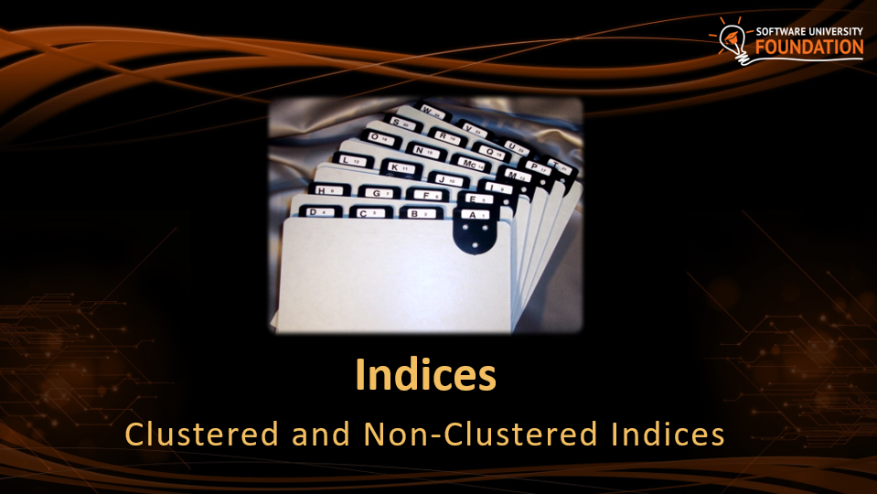
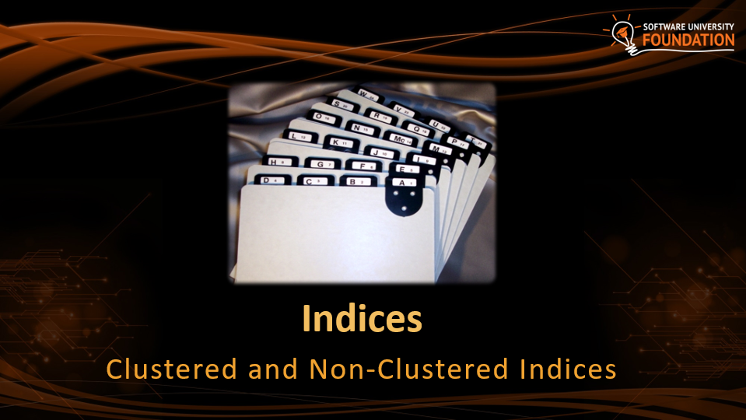
Table of Content

Slide 3
Questions
sli.do #JavaDB

Slide 4

JOINS
Gathering Data From Multiple Tables

Slide 5
Data from Multiple Tables
Sometimes you need data from several tables:
Employees
Departments
employee_name | department_id
Edward | 3
John | NULL
department_id | department_name
3 | Sales
4 | Marketing
5 | Purchasing
employee_name | department_id | department_name
Edward | 3 | Sales
Notes:
Data from Multiple Tables
Sometimes you need to use data from more than one table. In the slide example, the report displays data from two separate tables.
To produce the report, you need to link (join) the Employees and Departments tables and access data from both of them.

Slide 6
Cartesian Product
This will produce Cartesian product:
The result:
SELECT last_name, name AS department_name
FROM employees, departments;
last_name | department_name
Gilbert | Engineering
Brown | Engineering
… | …
Gilbert | Sales
Brown | Sales

Slide 7
Cartesian Product (2)
Each row in the first table is paired with all the rows in the second table
When there is no relationship defined between the two tables
Formed when:
A join condition is omitted
A join condition is invalid
To avoid, always include a valid JOIN condition

Slide 8
JOINS
JOINS – used to collect data from two or more tables
Types:
INNER JOIN
LEFT JOIN
RIGHT JOIN
OUTER (UNION) JOIN
CROSS JOIN
Notes:
These are SQL99 compliant joins

Slide 9
Tables
id | name | course_id
1 | Alice | 1
2 | Michael | 1
3 | Caroline | 2
4 | David | 5
5 | Emma | NULL
id | name
1 | HTML5
2 | CSS3
3 | JavaScript
4 | PHP
5 | MySQL
Notes:
These are SQL99 compliant joins

Slide 10
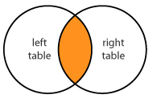
INNER JOIN
Produces a set of records which match in both tables
students_name | courses_name
Alice | HTML5
Michael | HTML5
Caroline | CSS3
David | MySQL
SELECT students.name, courses.name
FROM students
INNER JOIN courses
ON students.course_id = courses.id
Join Conditions

Slide 11
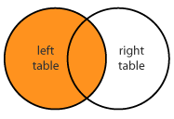
LEFT JOIN
Matches every entry in left table regardless of match in the right
students_name | courses_name
Alice | HTML5
Michael | HTML5
Caroline | CSS3
David | MySQL
Emma | NULL
SELECT students.name, courses.name
FROM students
LEFT JOIN courses
ON students.course_id = courses.id
Join Conditions

Slide 12
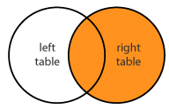
RIGHT JOIN
Matches every entry in right table regardless of match in the left
students_name | courses_name
Alice | HTML5
Michael | HTML5
Caroline | CSS3
NULL | JavaScript
NULL | PHP
David | MySQL
SELECT students.name, courses.name
FROM students
RIGHT JOIN courses
ON students.course_id = courses.id
Join Conditions

Slide 13
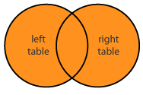
OUTER (FULL JOIN)
Returns all records in both tables regardless of any match
Less useful than INNER, LEFT or RIGHT JOINs and it's not implemented in MySQL
We can use UNION of a LEFT and RIGHT JOIN
Notes:
Full joins match all the data in the left and the right table. If any of the values doesn’t the join conditions the return value is NULL.

Slide 14
UNION of LEFT and RIGHT JOIN
SELECT students.name, courses.name
FROM students
LEFT JOIN courses
ON students.course_id = courses.id
UNION
SELECT students.name, courses.name
FROM students
RIGHT JOIN courses
ON students.course_id = courses.id
students_name | courses_name
Alice | HTML5
Michael | HTML5
Caroline | CSS3
David | MySQL
Emma | NULL
NULL | JavaScript
NULL | PHP
Notes:
Full joins match all the data in the left and the right table. If any of the values doesn’t the join conditions the return value is NULL.

Slide 15
CROSS JOIN
Produces a set of associated rows of two tables
Multiplication of each row in the first table with each in second
The result is a Cartesian product, when there's no condition in the WHERE clause
SELECT * FROM courses AS c
CROSS JOIN students AS s;
No Join Conditions
Notes:
Full joins match all the data in the left and the right table. If any of the values doesn’t the join conditions the return value is NULL.

Slide 16
Cross Join
Courses
Students
id | name
1 | HTML5
2 | CSS3
3 | JavaScript
4 | PHP
5 | MySQL
id | name | course_id
1 | Alice | 1
2 | Michael | 1
3 | Caroline | 2
4 | David | 5
5 | Emma | NULL
Result
course_id | course_name | student_id | student_name
1 | HTML5 | 1 | Alice
1 | HTML5 | 2 | Michael
1 | HTML5 | 3 | Caroline
… | … | … | …

Slide 17
Join Overview
employee_name | department_id
Sally | 13
John | 10
Michael | 22
Bob | 11
Robin | 7
Jessica | 15
department_id | department_name
7 | Executive
8 | Sales
10 | Marketing
12 | HR
18 | Accounting
22 | Engineering
Relation

Slide 18
Join Overview: INNER JOIN
employee_name | department_id
Sally | 13
John | 10
Michael | 22
Bob | 11
Robin | 7
Jessica | 15
department_id | department_name
7 | Executive
8 | Sales
10 | Marketing
12 | HR
18 | Accounting
22 | Engineering

Slide 19
Join Overview: LEFT JOIN
employee_name | department_id
Sally | 13
John | 10
Michael | 22
Bob | 11
Robin | 7
Jessica | 15
department_id | department_name
7 | Executive
8 | Sales
10 | Marketing
12 | HR
15 | Shipping And Receiving
18 | Accounting
22 | Engineering
NULL | NULL

Slide 20
Join Overview: RIGHT JOIN
employee_name | department_id
Sally | 13
John | 10
Michael | 22
Bob | 11
Robin | 7
Jessica | 15
department_id | department_name
7 | Executive
8 | Sales
10 | Marketing
12 | HR
18 | Accounting
22 | Engineering

Slide 21
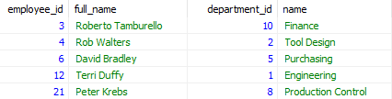
Problem: Managers
Get information about the first 5 managers in the "soft_uni" database
id
full_name
department_id
department_name
Notes:
A subquery or nested query is a query within another SQL query and embedded within the WHERE clause. Its main purpose is to serve as a data filter for the main query. It can be used after any of the operators(>,<, =, !=, IN, BETWEEN). A subquery can return a single value or multiple values.

Slide 22
Solution: Managers
SELECT e.employee_id, CONCAT(first_name, " ", last_name) AS `full_name`, d.department_id, d.name
FROM employees AS e
RIGHT JOIN departments AS d
ON d.manager_id = e.employee_id
ORDER BY e.employee_id LIMIT 5;
Notes:
A subquery or nested query is a query within another SQL query and embedded within the WHERE clause. Its main purpose is to serve as a data filter for the main query. It can be used after any of the operators(>,<, =, !=, IN, BETWEEN). A subquery can return a single value or multiple values.

Slide 23
Subqueries
☰
☰
☰
Query Manipulation on Multiple Levels

Slide 24
Subqueries
Subqueries – SQL query inside a larger one
Can be nested in SELECT, INSERT, UPDATE, DELETE
Usually added within a WHERE clause
SELECT * FROM students
WHERE course_id = 1;
id | name | course_id
1 | Alice | 1
2 | Michael | 1
Subquery
Notes:
A subquery or nested query is a query within another SQL query and embedded within the WHERE clause. Its main purpose is to serve as a data filter for the main query. It can be used after any of the operators(>,<, =, !=, IN, BETWEEN). A subquery can return a single value or multiple values.

Slide 25
Problem: Higher Salary
Count the number of employees who receive salary, higher than the average
Use "soft_uni" database
employee_id | first_name | last_name | …
216 | Mike | Seamans | …
178 | Barbara | Moreland | …
… | … | … | …
count
88
Table "employees"
Notes:
A subquery or nested query is a query within another SQL query and embedded within the WHERE clause. Its main purpose is to serve as a data filter for the main query. It can be used after any of the operators(>,<, =, !=, IN, BETWEEN). A subquery can return a single value or multiple values.

Slide 26
Solution: Higher Salary
SELECT COUNT(e.employee_id) AS `count`
FROM employees AS e
WHERE e.salary >
(
SELECT AVG(salary) AS 'average_salary' FROM employees
);
Notes:
A subquery or nested query is a query within another SQL query and embedded within the WHERE clause. Its main purpose is to serve as a data filter for the main query. It can be used after any of the operators(>,<, =, !=, IN, BETWEEN). A subquery can return a single value or multiple values.

Slide 27

Indices
Clustered and Non-Clustered Indices
Notes:
Every table can have only one clustered indexes. They are stored on the table. Clustered indexes sorts the data physically in the table so the reads are much faster. The most common index structure are the B-trees. However, when you have an index inserts and deletes it takes more time to accomplish because indexes has to be updated as well. A non-clustered index has a duplicate of the data from the indexed columns kept ordered together with pointers to the actual data rows (pointers to the clustered index if there is one). This means that accessing data through a non-clustered index has to go through an extra layer of indirection. However, if you select only the data that's available in the indexed columns you can get the data back directly from the duplicated index data.

Slide 28
Indices
Structures associated with a table or view that speeds retrieval of rows
Usually implemented as B-trees
Indices can be built-in the table (clustered) or stored externally (non-clustered)
Adding and deleting records in indexed tables is slower!
Indices should be used for big tables only (e.g. 50 000 rows)

Slide 29
Clustered Indices
Clustered indexe determine the order of data
Very useful for fast execution of WHERE, ORDER BY and GROUP BY clauses
Maximum 1 clustered index per table
If a table has no clustered index, its data rows are stored in an unordered structure (heap)
Keys
0-99
100-199
200-299
Data
☰
☰
☰
☰
☰
☰
☰

Slide 30
Non-Clustered Indices
Useful for fast retrieving a single record or a range of records
Each key value entry has a pointer to the data row that contains the key value
Maintained in a separate
structure in the DB
Keys
0-99
100-199
200-299
Pointers
1885,1885
6587,6589
8052,8053
Data
☰
☰
☰
☰
☰
☰
☰

Slide 31
Indices Syntax
CREATE INDEX ix_users_first_name_last_name
ON users(first_name, last_name);
Columns
Table Name

Slide 32


Summary
Joins
Subqueries are used to nest queries
Indices improve SQL search performance if used properly
SELECT * FROM employees AS e
JOIN departments AS d ON d.department_id = e.department_id
Databases

Slide 33








Joins, Subqueries and Indices in MySQL Server
https://softuni.bg/courses/databases-basics-mysql

Slide 34
License
This course (slides, examples, demos, videos, homework, etc.) is licensed under the "Creative Commons Attribution-NonCommercial-ShareAlike 4.0 International" license
Attribution: this work may contain portions from
"Databases" course by Telerik Academy under CC-BY-NC-SA license

Slide 35




Free Trainings @ Software University
Software University Foundation – softuni.org
Software University – High-Quality Education, Profession and Job for Software Developers
softuni.bg
Software University @ Facebook
facebook.com/SoftwareUniversity
Software University Forums
forum.softuni.bg

